Slide 1
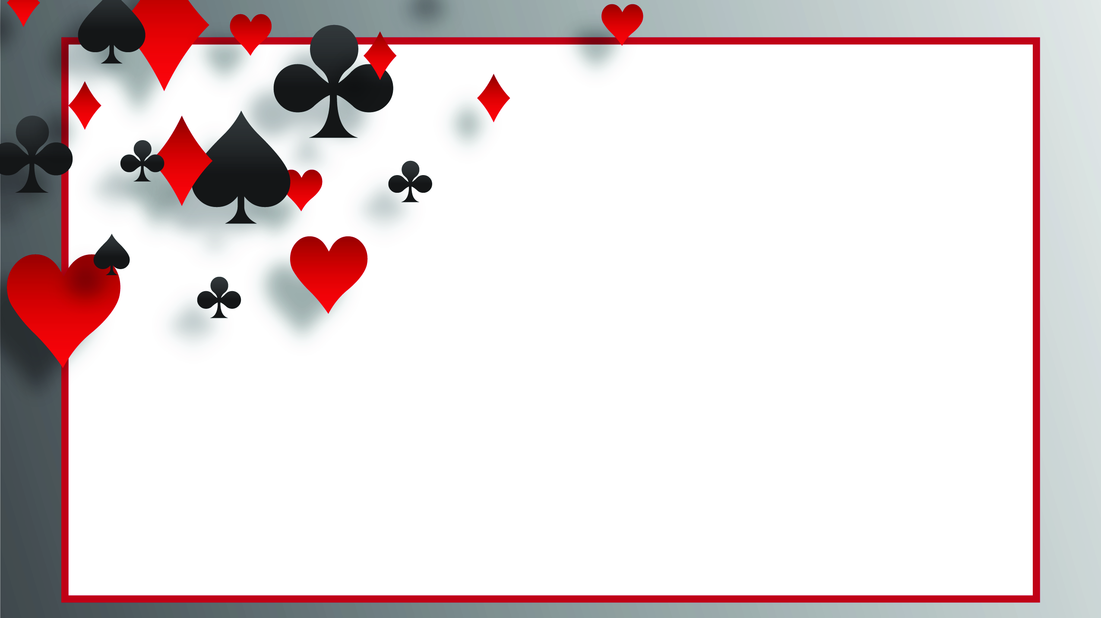

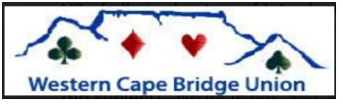
Lebensohl over wk 2’s and good bad 2 nt.

Slide 2

First a Few Thoughts
Partnership Bidding
Aggressive system with discipline
Regular system aggressively
I see far too many pairs playing an individual with stationary partner.

Slide 3
Despite our success in Shanghai, Tim and I decided we needed to open most 11 count wk nt’s
This caused a rethink of the entire system including a switch to 14-16 nt’s.
Because if you open most 11 counts, a range of 11-14 is too big.
We were tougher to play against, but my play was not as good.

Slide 4
Know Your Limitations
I mention the preceding because my declarer play suffered
But that has nothing to do with the bidding?

Slide 5
My checklist for adding a convention
1. Does it have enough frequency?
2. Does it replace a bid that is necessary?
3. Does it have an inference when not used?
Is it worth the memory work?

Slide 6
The Question at the Intermediate/Advanced
1. How many of my partners play it?
2. Will we all play it the same way?

Slide 7
Let’s Start with Lebensohl over Weak 2’s
The opponents pre-empt to take room away from us.
We need to find different ways to show different hands.

Slide 8
The opponents open 2S and partner doubles
♠ T3
♥ 652
♦ QJ10843
♣ 62
You hold the following 2 hands.
Do you bid 3 diamonds with both?
What useful information are you sending to partner?
♠ T3
♥ A52
♦ QJ10843
♣ Q6

Slide 9
Lebensohl over Wk 2’s is similar to what Carol showed wrt nt
♠ T3
♥ 652
♦ QJ10843
♣ 62
2 nt asks partner to bid 3C and you will either pass of bid another suit to play, showing a wk hand.
3D directly shows a good hand but is not forcing.
With better hand cuebid
♠ T3
♥ A52
♦ QJ10843
♣ Q6

Slide 10
What hand is good enough to bid directly instead of via 2 nt?
8+ Total Points is about right.
For Total Points include distribution.

Slide 11
What do we lose?
You lose the ability to bid a Natural 2 nt.
What do I do with 9 HCP and a stopper?
That’s the whole idea behind pre-empts.

Slide 12
Do things change if the double is balancing?
I hope you know to transfer a king?

Slide 13
Should we extend this idea to other situations?
Definitely How about the auction 1s x 2s p p x

Slide 14
We will still use this to distinguish between 2 ranges
What are the ranges?
Upper limit is just below what would have made a free bid.

Slide 15
Now we have 3 Ranges
♠ T3
♥ A52
♦ Q108432
♣ Q2
A) 1s x 2s 3D
B) 1s x 2s p p x p 3d
C) 1s x 2s p p x p 2nt p 3c p 3d.
♠ T3
♥ A52
♦ Q108432
♣ J6
♠ T32
♥ 952
♦ J9542
♣ 86

Slide 16
Should we extend this idea to even more?
Of course, why else are we wasting a Sunday?

Slide 17
How do we get to 4 levels?
a) 1S x 2S 3D
b) 1S x 2S 2NT p 3C p 3D
c) 1S x 2S p p x p 3D
d) 1S x 2S p p x p 2NT p 3C p 3D

Slide 18
What’s all this stuff called?
Technically the first 2 are good/bad and the second 2 are extended lebensohl. But it is the same basic idea.

Slide 19
Can we have a rule on when this applies?
Tim and my rule was: “it is always good/bad or lebensohl except when 2 nt is necessary to be natural”.

Slide 20
Can we have some rules that WE can understand?
Let’s do the easy one first. Whenever you are forced to bid due to a double and your bid is at the 3 level, it applies.

Slide 21
Rules When it Should Not Apply
1. | 1H - (2D) - 2N | Right Hand Opponent shows opening values
2. | 1H - (1S) - 2N | Right Hand Opponent makes a 1 level bid
3. | 1H - (2H) - 2N | Right Hand Opponent makes a cuebid
4. | 1H - (P) - 1S - (1N); 2N | Opponent makes a conventional call, such as a Sandwich Notrump showing a two-suited weak hand
5. | (1C) - P - (1D) - 1S; (2C) - 2N | Opponents play a "strong Club" system, opening with an artificial bid
6. | (1H) - 2C - (X) - 2N | Right Hand Opponent does not make a suit bid
7. | 1N - (2H) - 2N | Right Hand Opponent overcalls partner's 1 Notrump opening bid
8. | 1D - (1S) - 2D - (P); 2N | Right Hand Opponent has passed.
9. | 1N - (2H) - 2N | Right Hand Opponent overcalls partner's 1 Notrump opening bid

Slide 22
Some Auctions Where You are Forced to bid When They Open?
2S X p $(for all 3 other suits)
2H X p $ (for minors)
2D X p $ (for clubs)
1S X 2S p p X p $
1C X 2S(Weak) p p X p $
1C X 1S p 2S X p $

Slide 23
Some Auctions Where You are Forced to bid When Partner Open?
1C 1S p 2S X p $
1C 2S p p X p $
1C 1S p 2D X p $
1C p p 2S X p $
1C X p 2S X p $

Slide 24
Do these Auctions Come Up Frequently? How About Tuesday?

Slide 25
Anything More?
Yes. When you open!
When you open and the bidding continues with a 2 level bid on your right. Then it also applies.

Slide 26
Some Auctions Where You Opened and want to use Good/Bad

Slide 27
Another Auction Where You Opened and want to use Good/Bad

Slide 28
Yet Another Auction Where You Opened and want to use Good/Bad

Slide 29
What Constitutes a Good Hand From Opener
If partner has bid, then 15-17. Less you use 2 NT, more you force to game. If partner has not, then a 3 to 5 points more than the minimum you would compete with.

Slide 30
How Do We Alert
If partner uses 2nt, we say partner wants to compete at the 3 level and has a stronger option available.
If partner bids at the 3 level, we say partner had a weaker option available to show this suit.

Slide 31
About Now You Are Saying Enough! I Can’t Remember All That
I totally agree. Especially as it will affect your play. So lets start with a subset.

Slide 32
A Suggested Order in Adding the Conventions
Lebensohl over weak 2’s. Slides 8-12.
Good/Bad 2NT by opener where his right hand opponent has bid above 2 clubs. Slides 26-28.
Extended Lebensohl on the second and third round of the bidding. Slides 13-16.
Good/Bad for free bids by responder. Slides 17.

Slide 33
Is It Worth It?
That’s up to you. The rest of your game will suffer until it gets hardwired.
Does it follow all our rules? Not quite.
It does have enough frequency.
It has a negative inference when not used. Do you know what that is?
Is it worth the memory work, I think so.
Does it replace a bid that is necessary. Sort of. You lose the ability to bid 2 nt naturally. With those sort of hands you will not have a good bid available. However the frequency of a natural 2 nt is very low.

Slide 34
Are there any other issues
Yes. Some pairs reverse it, so that the direct 3 level bid is weak and 2 nt starts the stronger sequence. Why? Because then the get more information about what to lead. I think this version is best at matchpoints, ours at imps.

Slide 35
What can you do to show the difference between these 6 hands if the bidding has gone:
1D 1S X 2S
How do you show the difference between a good hand and a hand that just wants to compete

